Slide 1
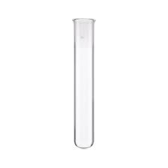


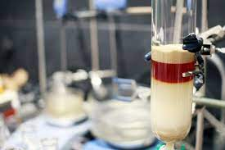

Senior Sophistor Year
Capstone Research Project
&
Problems Assignment
2024-25

Slide 2
Structure of the year
 | Semester 1 | Semester 2
Activities | Capstone Research Project Problem-solving through self-directed learning. | Taught modules Problem-solving through self-directed learning and tutorials.
Assessments | Viva voce examination of: capstone project problem-solving of “seen” problems covering years 1-3 of moderatorship | Written examinations: 6 papers for C 5 papers for MC 5 papers for CMM 2 CH papers for nanoscience
Semester 1 will focus on self-directed learning (development of problem solving skills) and on research work towards completion of capstone project.
Activities in semester 1 will be assessed via viva voce examination during the TCD scheduled assessment week.
During semester 2 students will enrol in taught modules and will continue to develop problem-solving skills. Activities in semester 2 will be assessed via written examination during the TCD scheduled assessment week, apart from problem paper….

Slide 3
Structure of the year
(May be subject to change)
Module | ECTS | Cohort |  |  |  |  | Viva |  | Paper
 |  | C | MC | CMM | N | Bio | % | Sem. | % | Sem. | time (h)**
CHU44120 | 20 | x |  |  |  |  | 100 | S1 | - | - | -
CHU44720 | 20 |  |  | x |  |  | 100 | S1 | - | - | -
CHU44420 | 20 |  | x |  |  |  | 100 | S1 | - | - | -
CHU44520 | 20 |  |  |  |  | x
CHU44123 | 5 | x | x | x |  | x | 30 | S1 | 70 | S2 | 3
CHU44204 | 5 | x | x | x |  | x | - | - | 100 | S2 | 1.5
CHU44004 | 5 | x | x | x | x | x | - | - | 100 | S2 | 1.5
CHU44304 | 5 | x | x | x | x | x | - | - | 100 | S2 | 1.5
CHU44205 | 10 | x | x | x |  |  | - | - | 100 | S2 | 3
CHU44005 | 10 | x |  | x | x |  | - | - | 100 | S2 | 3
CHU44167 | 10 | x |  | x | x |  | - | - | 100 | S2 | 3
CHU44705 | 10 | x |  | x | x |  | - | - | 100 | S2 | 3
CHU44405 | 10 |  | x |  |  |  | - | - | 100 | S2 | 3
BIU33350 | 5 |  |  |  | x |  |  |  | 100 | S1 | 1.5
BIU33250 | 5 |  |  |  | x |  |  |  | 100 | S2 | 1.5
BIU44610 | 10 |  |  |  | X |  |  |  | 100 | S2 | 3

Slide 4
Semester 1 – Important Dates
Capstone Research Project (20 credits) & Problem-Solving Module
Start of the Project: September 9th
Duration: 12 weeks
Safety workshop 10th of September
Electronic Submission of solutions to 6 Problems: 16.30 on November 15th 2024
Electronic Submission of Report: 16.30 on November 29th 2024
To create a fair evaluation method and to keep with college guidelines on plagiarism it has been decided to make use of the software embedded into blackboard during electronic report submission.
Electronic Submissions only!
Examination: The week of 9-14th of December 2024

Slide 5
Capstone Research Project – Structure of the Report
Discuss the structure and content of the report with your supervisor.
The report must be typed with font size 12, double line spaced, and not longer than 30 pages in length.
Your laboratory notebooks together with appendices of spectra etc. if appropriate must also be handed in at this time.
It is crucial that you allow sufficient time for the completion of your report. NB. Your supervisor must receive a draft copy of your report allowing sufficient time for feedback/corrections.
Discuss the writing with him/her! Know what is expected of you…..

Slide 6
Project - Safety
Standard safety regulations also apply to research laboratories: Lab-coats and safety glasses must be worn; eating and drinking is not allowed in the laboratories.
Access to research labs will be revoked immediately if you are found to be in breach of safety guidelines!
Project students should get a safety tour by supervisors; familiarise yourself with the locations of fire extinguishers, fire blankets, safety exits, showers
Plan your experiments well in advance; familiarise yourself with risks associated with starting materials, products (SDS), instruments etc.
Consult with supervisors/advisors to discuss safety aspects before starting the experiments
Overnight experiments need to be signed off by your supervisor.
College Emergency Number: Ext. 1999

Slide 7
Capstone Research Project – Structure of the Report
1. Introduction and Objectives of the Project: Identifies the scientific aims of the project and set this in context with other current and recent work
2. Results and Discussion: The experiments conducted, and results are set out and described. Results should be discussed and set in context with the recent literature so that their significance is evident. A clear story should be developed so that the reader is lead through the project, understanding why experiments were performed and the relevance of the results at each stage. The R&D section should lead on from the introduction, and into the conclusion, building on ideas from the introduction and clearly highlighting key results for the conclusion.
3. Experimental Sections/Materials and Methods: Experimental work should be described so that the experiments and results can be reproduced by other researchers. Appropriate characterisations and analyses need to be provided in order to provide evidence for the claims in the R&D section.
4. Conclusions and Future Work: The conclusions should be fully supported by the results. The conclusions should be discussed and set in the context of current and recent literature. The conclusions should be used to suggest a series of experiments highly likely to lead to further useful results which extend the current study into new and important areas.
5. References: related work and underlying concepts should be referenced; the references should obey the format of a recognised scientific journal (format of Angewandte Chemie, J. Am. Chem. Soc., (ACS) Chem. Commun. (RSC)...

Slide 8
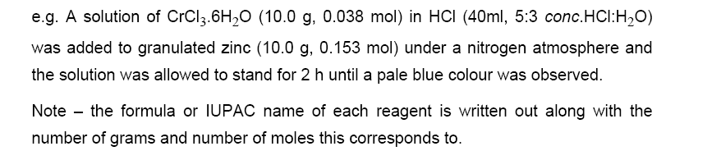
3. Experimental Sections/Materials and Methods:
This section is written in the 3rd person past passive voice and is a concise summary of what you did.
It should contain the actual procedure you carried out in the course of the experiment
It should include any modifications you had to make to the methods or reagents adopted elsewhere, s well as your observations, for example the solutions colours, the evolution of heat or gas, etc. It is never written as a series of numbered points. Reread your experimental think if you could repeat the experiment.
For more examples of this style look in any chemistry journal

Slide 9
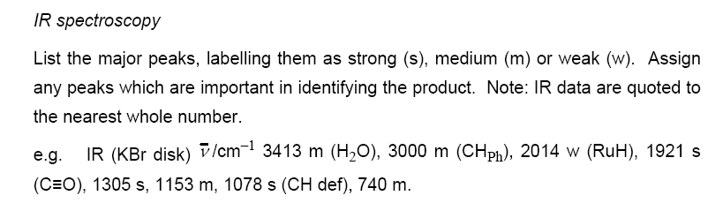
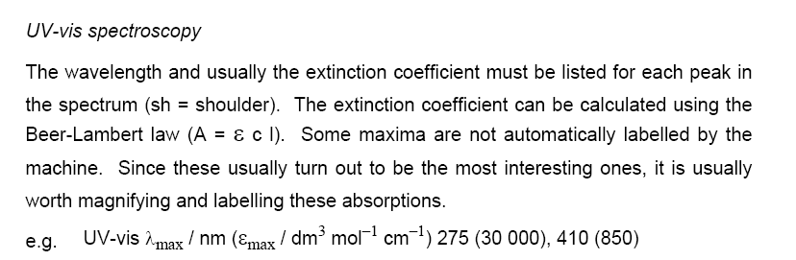

Slide 10
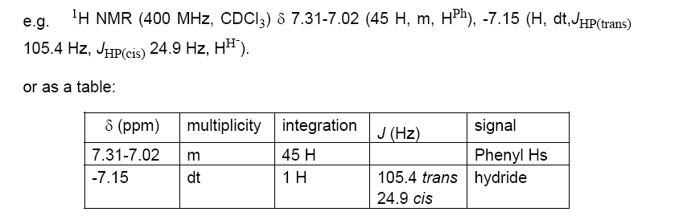
NMR Spectroscopy:
It is important to include:
the nucleus (e.g. ¹H, ¹³C, ³¹P). Remember ¹³C and ¹³C{¹H} are not the same and you measure ¹³C{¹H} routinely
the frequency of the spectrometer (e.g. 250 MHz, 400 MHz)
the solvent (CDCl₃, D₂O)
the identity of the signal if it is known.
The order of the signals is from high to low field, (ie. from large to small ppm).
For proton spectra, the number of protons (the signal integration), the peak multiplicity, the coupling constant J in Hertz are also included.
Peak multiplicities are described as s = singlet, d = doublet, t = triplet, dd = doublet of doublets, dt = doublet of triplets, m = multiplet.
Remember that for proton signals the coupling constant is the interval between peaks multiplied by the frequency of the field in MHz.

Slide 11
3. Experimental Sections/Materials and Methods (in/organic):
N-[1-Methyl-pyprazino-ethyl]-4-nitro-1,8-naphthalimide, (8)
Compound 8 was synthesised by reacting 1-(2-aminoethyl)-4-methylpiperazine (2.47 g, 2.58 mL, 17.2 mmol, 1.4 eq.) with 4-nitro-1,8-naphthalic anhydride (3.0 g, 12.3 mmol, 1 eq.) and Et₃N (2.5 g, 3.56 mL, 24.6 mmol, 2 eq.) in anhydrous toluene (200 ml), to yield the product as a brown solid (3.50 g, 77%) after a recrystallisation from MeOH. m.p. 109 - 111 ºC; HRMS: 369.1554 ([M + H]⁺. C₁₉H₂₁N₄O₄ requires 369.1563); δ_{H} (400 MHz, CDCl₃), 8.85 (1H, d, J = 9.0 Hz, Ar-H7), 8.74 (1H, d, J = 7.5 Hz, Ar-H5), 8.70 (1H, d, J = 8.0 Hz, Ar-H2), 8.42 (1H, d, J = 8.0 Hz, Ar-H3), 8.00 (1H, t, J = 8.0 Hz, Ar-H6), 4.36 (2H, t, J = 7.0 Hz, NCH₂CH₂N(CH₂CH₂)₂NCH₃), 2.73 (2H, t, J = 7.0 Hz, NCH₂CH₂N(CH₂CH₂)₂NCH₃), 2.65(4H, s, NCH₂CH₂N(CH₂CH₂)₂NCH₃), 2.44 (4H, br. s, NCH₂CH₂N(CH₂CH₂)₂NCH₃), 2.28 (3H, s, NCH₂CH₂N(CH₂CH₂)₂NCH₃); δc (100 MHz, CDCl₃), 162.7, 161.9, 149.0, 131.8, 129.4, 129.2, 128.7, 128.5, 126.4,123.4, 123.1, 122.4, 54.9, 54.6, 52.7, 45.5, 45.5, 37.3; m/z: 369 (M + H)⁺; ν_{max} (neat sample)/cm⁻¹ 3078, 2928, 2793, 2757, 1655, 1522,1339, 824, 761.

Slide 12
Hint and tips (a.k.a the voice of experience)
In the lab:
There is no such thing as a stupid question. Don’t be afraid to ask for help.
Be organised, meticulous and tidy – there are no such things as short cuts
You have your spectroscopic data but look at it now not when you write up. Is it correct? Do you need to remove the last traces of toluene to get a nice spectrum? A printed spectrum is not an assigned spectrum so get the integrations, chemical shifts and assignments done straight away.
Don’t be afraid to ask for help
Literature searching:
Use some of the search engines and not just Wikipedia
Referencing your R&D section is easier as you go along
Care is needed when using citation managers (endnote) as it does not just work
Writing up:
Everything takes π times longer than you expect; don’t leave it until the last minute
Pay attention to your experimental section.
The intro, R&D and conclusions should tell a story; hold the reader’s hand through your story!

Slide 13

Literature Searching

Slide 14
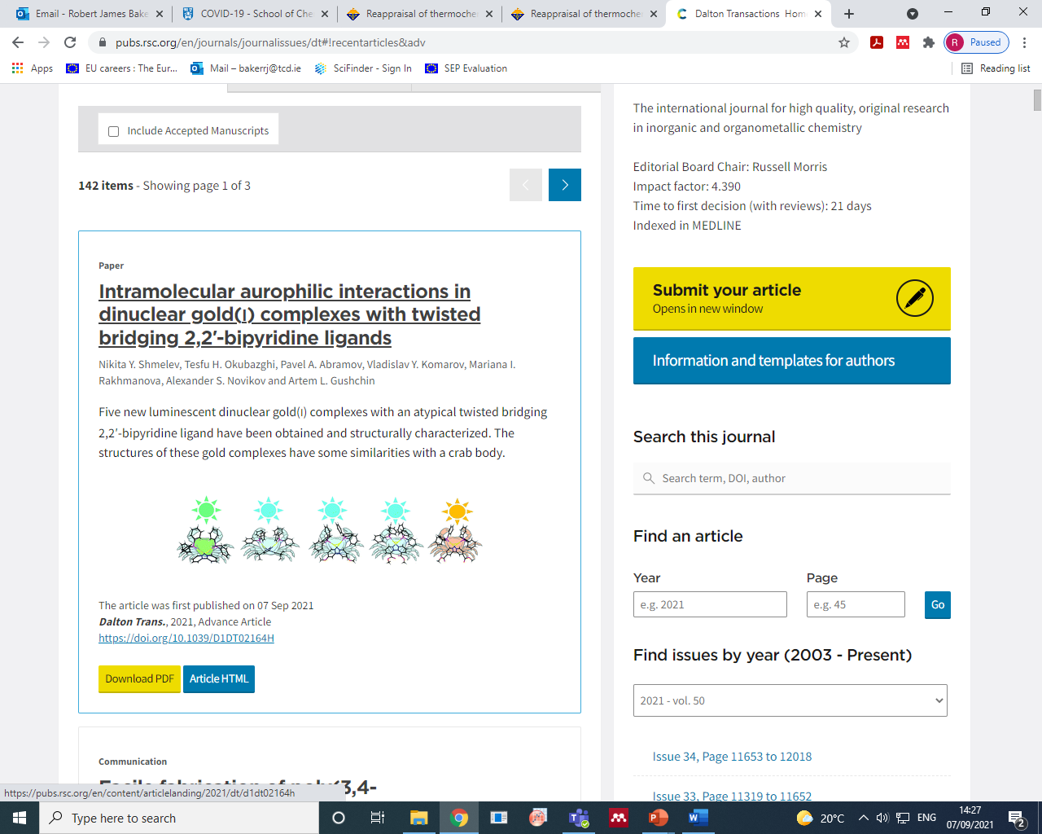
Literature Searching
Online access at home:
take https://pubs.rsc.org/en/content/articlelanding/2021/dt/d1dt02164h
And modify the address to:
http://pubs.rsc.org.elib.tcd.ie/en/content/articlelanding/2021/dt/d1dt02164h

Slide 15
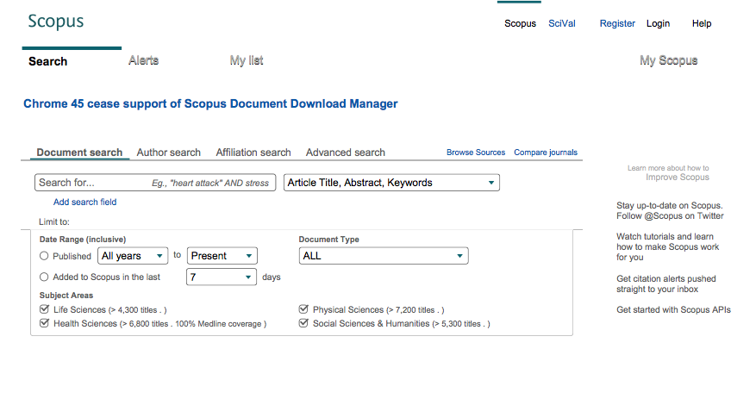
Literature Searching

Slide 16
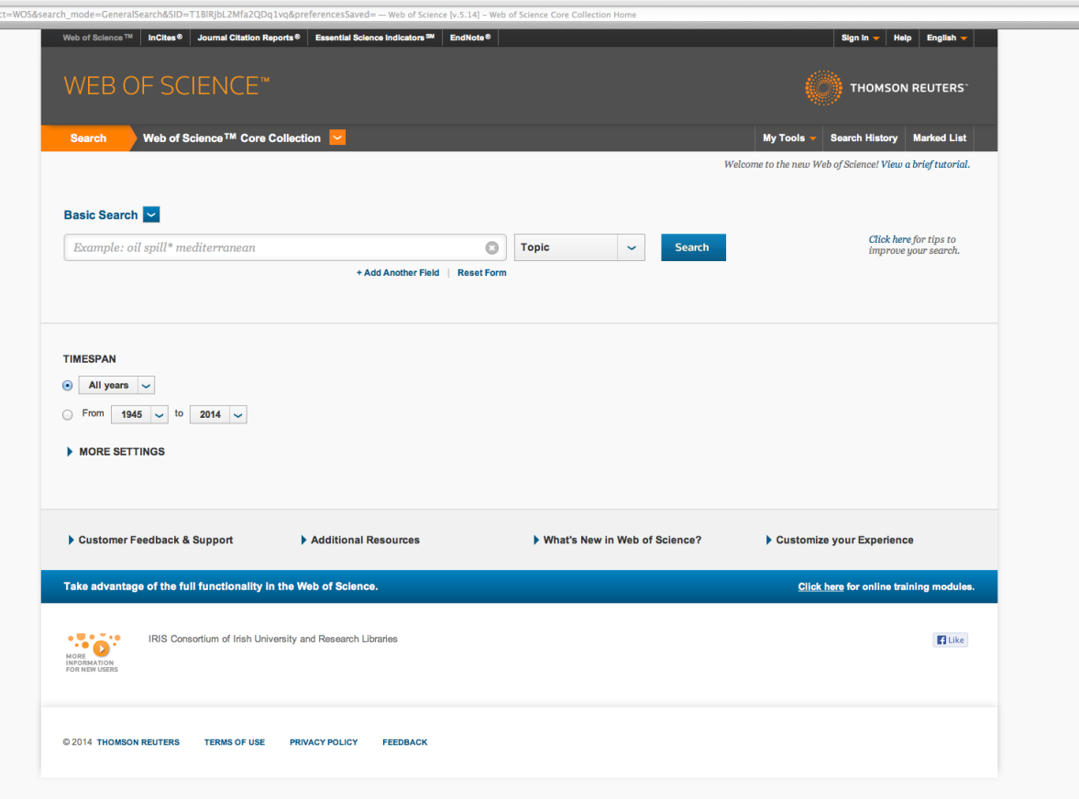
Literature Searching

Slide 17
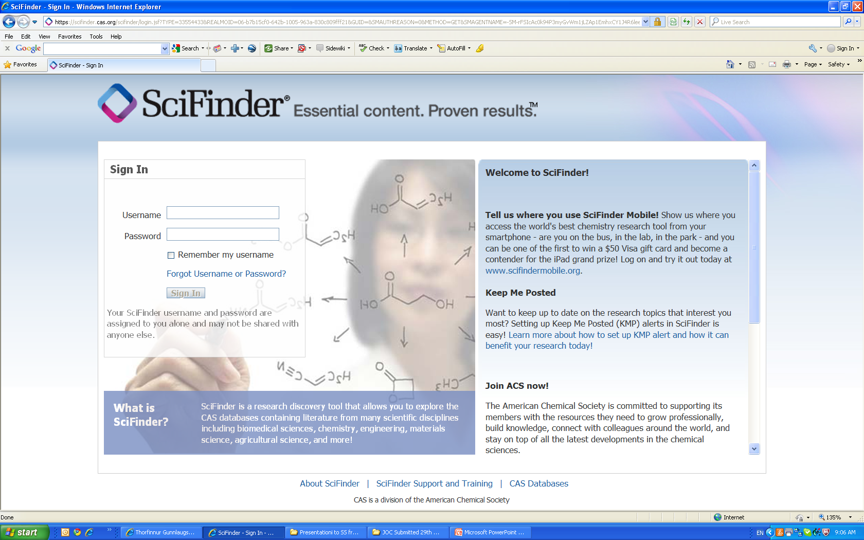
Literature Searching

Slide 18
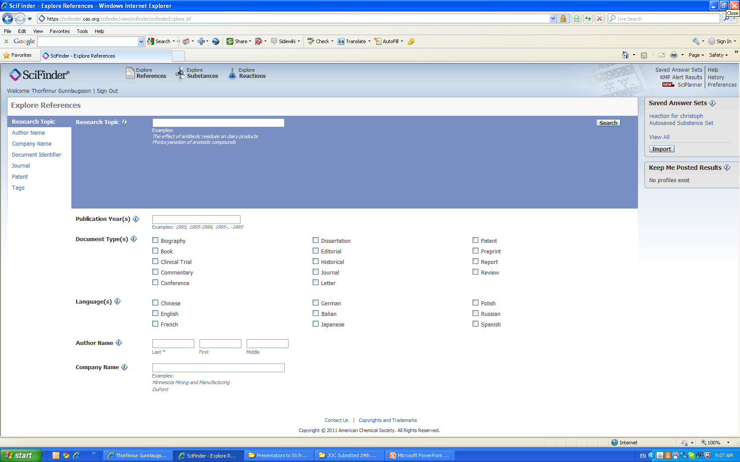
Literature Searching

Slide 19
Capstone Research Project – Assessment
Project Assessment: Your project work will be assessed by:
three examiners:
Supervisor (20%): will submit a written report on the work conducted.
Two other assessors (40% ea.): will mark the project report and conduct a formal assessment involving a 10 min. presentation by the student followed by a 20min question & answer session in which the work and underlying theoretical concepts will be discussed. The problems will then be discussed.
Dates for presentations: Semester 1 (9th-14th December). These will be in person
Marks for your project will be allotted on the basis of quality of content, presentation, effort made, and performance during the oral examination….

Slide 20
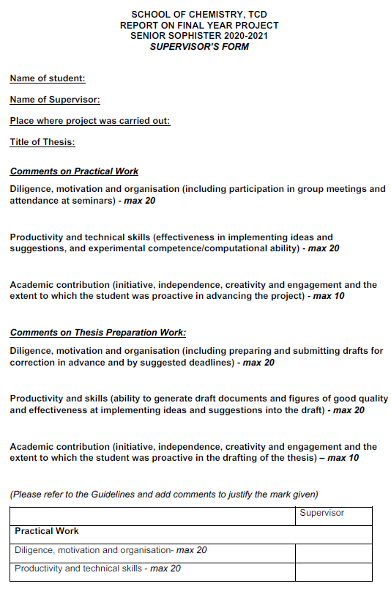
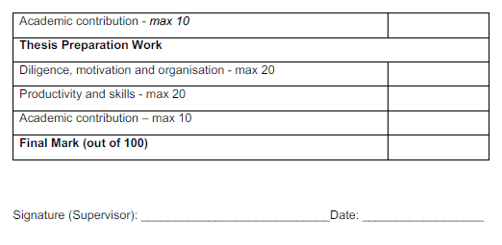


Slide 21
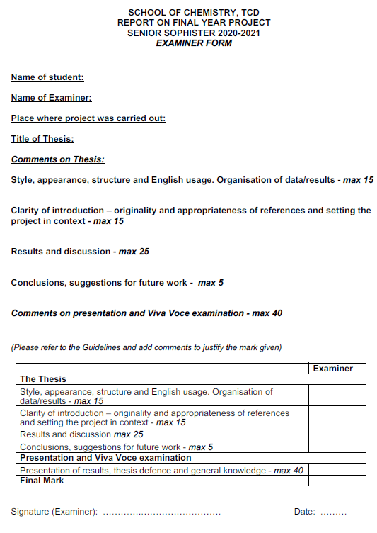

Slide 22
Problem Solving – Assignment
Module codes: CHU44123
Credit bearing: 10 ECTS (30% assessed in S1 viva assessment, 70% assessed in examination paper in S2*)
In semester 1, you will be given one assignment with a total of 6 problems covering years 1-3 of your moderatorship.
You will solve the problems in an independent manner; if you find errors in the questions then discuss this in your answer!
You are encouraged to consult textbooks and scientific literature to work on your solutions but are not allowed to copy solutions from fellow students.
After submission of your solutions you are free to discuss the problems with others in your SS class.
You must submit your solutions to all six problems via blackboard after study week, by Friday November 15th.

Slide 23
Problem Solving – Viva Voce Assessment
Viva voce examination for problem solving component will take place on the same day of your Research Project viva voce examination.
This section of the viva will be 10 min long and will take place after the discussion of the project is closed.
The assessors will select one of the 6 problems in the assignment and will ask the student to solve either the problem or a section of it during the examination (pen and paper or blackboard), and discuss/articulate the approach taken.
You might be asked to identify, discuss and/or correct any mistakes made in the submission.

Slide 24
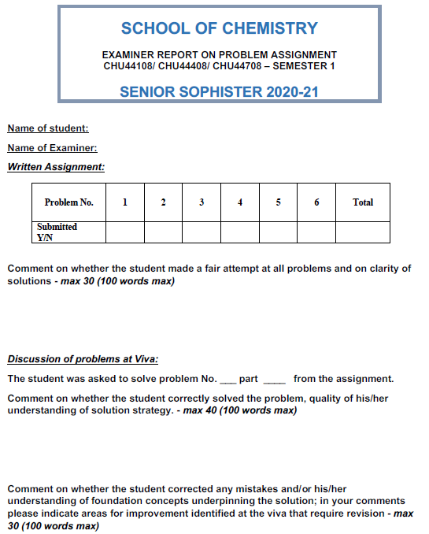
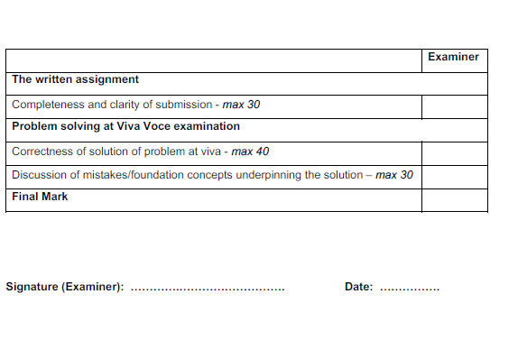
New for this year 20/100
New for this year 50/100

Slide 25
Moderatorship Examinations
The Final degree mark: 30% from JS Mark and 70% from the SS year.
Project mark + Problem Solving Mark in Semester 1 : 21.5 credits ≈ 35.83%
Examinations in Semester 2: 38.5 credits ≈ 64.17%
External examiners:
External examiners (for Chem, MedChems and CMMs) will visit for two days after semester 2 examinations (either in person or virtual). Dates to be confirmed
As a result of new calendar regulations, students will have the right to reassessment in their final year on all modules except the capstone project. Students who do not pass the sophister examinations will be able to repeat the year.

Slide 26
New for this year
Capping of reassessment grades
From this academic year, ANY resit attempt will be capped at 60%. The reason for this is in the past students have deliberately failed some modules in order to give themselves extra time to revise. This is unfair on students who revise for all modules. This was approved by the Senior Lecturer subject to the following conditions:
(i) to carry out a review of the performance of the derogation from an academic, logistic and student perspectives after two years so as to understand expected & unexpected consequences of the derogation. This means that any continuance of the derogation is contingent on the satisfactory performance of the derogation
(ii) that all affected students are fully informed of the change in (re)assessment (i.e. the derogation) at the beginning of term and the reasons for the change in (re)assessment rules derogation.

Slide 27
Summary of important dates
 | TCD Project | Project Abroad
Start | 9th September | 9th September (approx.)
End Project work | 22nd November | 22nd November
Hand in Project Report | 29th November | 29th November
Supervisors Mark | Supervisor 20% | External Supervisor 20%
Presentation | 9th-14th December | 9th-14th December
Presentations / review | Examiners 80% | Examiners 80%

Slide 28

Key dates
Call open | 29 August 2024
FAQ deadline | 16:00 (Irish time) 03 October 2024
Applicant deadline | 16:00 (Irish time) 10 October 2024
Supervisor /Mentor deadline | 16:00 (Irish time) 17 October 2024
Research office endorsement deadline | 16:00 (Irish time) 24 October 2024
Call outcome | End of April 2025
http://research.ie/funding/goipg/

Slide 29
Contacts:
Prof. Bob Baker Prof. Matthias Möbius
SS Year Coordinator NPCAM Director
bakerrj@tcd.ie NPCAM@tcd.ie
Prof. Valeria Nicolosi Prof. Mike Southern
Director of Teaching & Learning (UG) Associate Director of Teaching & Learning (UG)
nicolov@tcd.ie SOUTHERJ@tcd.ie
Prof. Aidan McDonald Prof. Eoin Scanlon
Head of Discipline Head of Discipline
Inorganic & Synthetic Materials Organic, Medicinal & Biological Chemistry
aidan.mcdonald@tcd.ie SCANLAE@tcd.ie
Prof. Mike Southern Prof. Paula Colavita
Director of Medicinal Chemistry Head of Discipline
southerj@tcd.ie Physical, Computational & Materials Chemistry colavitp@tcd.ie
For help with Mental Health problems use your tutor, student counselling, your GP….

